Slide 1

Chapter 1:Introduction to NodeJS
Dr. Adeel Ansari

Slide 2
Your instructor
Dr. Adeel Ansari
Assistant Professor/ Program Manager - PhD Computing/ Editor of JISR-C Journal
Office: Room 102-B, 100 Building
email: adeel.ansari@szabist.edu.pk
Personal Portal: www.adeelansari.com
My Biography:
PhD in Information Technology, University Technology PETRONAS, Malaysia, 2016
MS (Software Engineering), PAF-KIET, Pakistan, 2011
MBA(MIS), PAF-KIET, Pakistan, 2008
BSc(Hons) in Computing, Staffordshire University, UK, 2006.

Slide 3
Motive of this course
This course explains how to use Node.JS to create interactive web pages. After completing this course, students will be able to use Node.JS effects and animations on your web pages.
This course will start off by teaching you the basics of Node.js and its core modules. Students will then learn how to import additional modules and configure your project using npm. From there, you will learn how to use Express to set up a web server and how to interact with a MongoDB database using Mongoose.

Slide 4
What is Node.JS
Node.js is a server side platform built on Google Chrome’s JavaScript Engine (V8).
Node.js was developed by Ryan Dahl in 2009 and is an open source, cross-platform runtime environment for developing server-side and networking applications. Node.js applications are written in JavaSCript, and can be run within the Node.js runtime on Windows and Linux.
Node.js provides a rich library of various JavaScript modules which simplifies the development of web applications using Node.js to a great extent
Node.js=Runtime Environment+JavaScript Library

Slide 5
Features of Node.js
Following are some of the important features that make Node.js the first choice of software architects.
1. Asynchronous and Event Driven – All APIs of Node.js library are asynchronous, that is, non-blocking. It essentially means a Node.js based server never waits for an API t o return data. The server moves to the next API after calling it and a notification of Events of Node.js helps the server to get a response from previous API call.
2. Very Fast – Being built on Google Chrome’s V8 JavaScript Engine, Node.js library is very fast in code execution.
3. Single Threaded but highly Scalable – Node.js uses a single threaded model with event looping. Event mechanism helps th server to respond in a non-blocking way and makes the server highly scalable as opposed to traditional servers which create limited threads to handle requests Node.js uses a single threaded program and the same program can provide service to a much larger number of requests than traditional servers like Apache HTTP server.
4. No Buffering – Node.js applications never buffer any data. These applications simply output the data in chunks.

Slide 6
I/O Asynchronous Non-Blocking Callback
When Node.js needs to perform an I/O operation, like reading from the network, accessing a database or the file system, instead of blocking the thread and wasting CPU cycles waiting, Node.js will resume the operations when the response comes back.
This allows Node.js to handle thousands of concurrent connections with a single server without introducing the burden of managing thread concurrency, which could be a significant source of bugs.

Slide 7
Vast Number of Libraries
Npm with its simple structure helped the ecosystem of Node.js proliferate, and now the npm registry hosts over 1,000,000 open source packages you can freely use.

Slide 8
An Example Node.js Application
The most common example Hello World of Node.js is a web server:
This code first includes the Node.js http module.
Node.js has a fantastic standard library, including first-class support for networking.
The createServer() method of http creates a new HTTP server and returns it.
The server is set to listen on the specified port and hostname. When the server is ready, the callback function is called, in this case informing us that the server is running.
Whenever a new request is received, the request event is called, providing two objects: a request (an http.IncomingMessage object) and a response (an http.ServerResponse object).
const hostname = '127.0.0.1'
const port = process.env.PORT
const server = http.createServer((req, res) => {
res.statusCode = 200
res.setHeader('Content-Type', 'text/plain')
res.end('Hello World!\n')
})
server.listen(port, hostname, () => {
console.log(`Server running at http://${hostname}:${port}/`)
})

Slide 9
An Example Node.js Application
The first provides the request details. In this simple example, this is not used, but you could access the request headers and request data.
The second is used to return data to the caller.
In this case with:
we set the statusCode property to 200, to indicate a successful response.
We set the Content-Type header:
and we end close the response, adding the content as an argument to end():
res.statusCode = 200
res.setHeader('Content-Type', 'text/plain')
res.end('Hello World\n')

Slide 10
Another example of node.js
var http = require('http'); http.createServer(function (req, res) { res.writeHead(200, {'Content-Type': 'text/plain'}); res.end('Hello World!'); }).listen(8080);

Slide 11
Node.js Frameworks and Tools
Node.js is a low-level platform. In order to make things easy and exciting for developers, thousands of libraries were built upon Node.js by the community.
Many of those established over time as popular options. Here is a non-comprehensive list of the ones worth learning:
AdonisJs: A full-stack framework highly focused on developer ergonomics, stability, and confidence. Adonis is one of the fastest Node.js web frameworks.
Express: It provides one of the most simple yet powerful ways to create a web server. Its minimalist approach, unopinionated, focused on the core features of a server, is key to its success.

Slide 12
Node.js Frameworks and Tools
Fastify: A web framework highly focused on providing the best developer experience with the least overhead and a powerful plugin architecture. Fastify is one of the fastest Node.js web frameworks.
hapi: A rich framework for building applications and services that enables developers to focus on writing reusable application logic instead of spending time building infrastructure.
koa: It is built by the same team behind Express, aims to be even simpler and smaller, building on top of years of knowledge. The new project born out of the need to create incompatible changes without disrupting the existing community.
Loopback.io: Makes it easy to build modern applications that require complex integrations.

Slide 13
Node.js Frameworks and Tools
Meteor: An incredibly powerful full-stack framework, powering you with an isomorphic approach to building apps with JavaScript, sharing code on the client and the server. Once an off-the-shelf tool that provided everything, now integrates with frontend libs React, Vue, and Angular. Can be used to create mobile apps as well.
Micro: It provides a very lightweight server to create asynchronous HTTP microservices.
NestJS: A TypeScript based progressive Node.js framework for building enterprise-grade efficient, reliable and scalable server-side applications.
Next.js: A framework to render server-side rendered React applications.
Nx: It powers the Angular CLI which allows building full-stack applications using NestJS, Express, and Angular and easily share code between backends and frontends.
Socket.io: A real-time communication engine to build network applications.

Slide 14
Who Uses Node.js
There is an exhaustive list of projects, application and companies which are using Node.js. This list includes eBay, General Electric, GoDaddy, Microsoft, PayPal, Uber, Wikipins, Yahoo! And Yammer to name a few.

Slide 15
Where to Use Node.js
I/O bound Applications
Data Streaming Applications
Data Intensive Real-time Applications (DIRT)
JSON APIs based Applications
Single Page Applications

Slide 16
Where Not to Use Node.js
It is not advisable to use Node.js for CPU intensive applications.

Slide 17
What Can Node.js Do?
Node.js can generate dynamic page content
Node.js can create, open, read, write, delete, and close files on the server
Node.js can collect form data
Node.js can add, delete, modify data in your database

Slide 18
What is a Node.js File?
Node.js files contain tasks that will be executed on certain events
A typical event is someone trying to access a port on the server
Node.js files must be initiated on the server before having any effect
Node.js files have extension ".js"

Slide 19
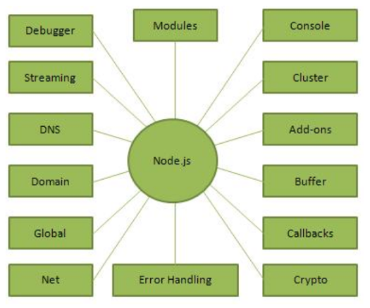
Concepts
The following diagram depicts some important parts of Node.js which we will discuss in detail in the subsequent chapters.

Slide 20
Node.js Built-in Modules
Module | Description
assert | Provides a set of assertion tests
buffer | To handle binary data
child_process | To run a child process
cluster | To split a single Node process into multiple processes
crypto | To handle OpenSSL cryptographic functions
dgram | Provides implementation of UDP datagram sockets
dns | To do DNS lookups and name resolution functions
domain | Deprecated. To handle unhandled errors
events | To handle events
fs | To handle the file system
http | To make Node.js act as an HTTP server
https | To make Node.js act as an HTTPS server.
net | To create servers and clients
os | Provides information about the operation system
path | To handle file paths
punycode | Deprecated. A character encoding scheme
querystring | To handle URL query strings
readline | To handle readable streams one line at the time
stream | To handle streaming data
string_decoder | To decode buffer objects into strings
timers | To execute a function after a given number of milliseconds
tls | To implement TLS and SSL protocols
tty | Provides classes used by a text terminal
url | To parse URL strings
util | To access utility functions
v8 | To access information about V8 (the JavaScript engine)
vm | To compile JavaScript code in a virtual machine
zlib | To compress or decompress files
Node.js has a set of built-in modules which you can use without any further installation.
Here is a list of the built-in modules of Node.js version 6.10.3:

Slide 21
Getting started with node.js
Dr. Adeel Ansari

Slide 22
Software needed
Preferred Text Editors:
Visual Studio Code
Atom
Sublime
In this course, we will work with Visual Studio Code.
Download and install the Node.js from https://nodejs.org

Slide 23
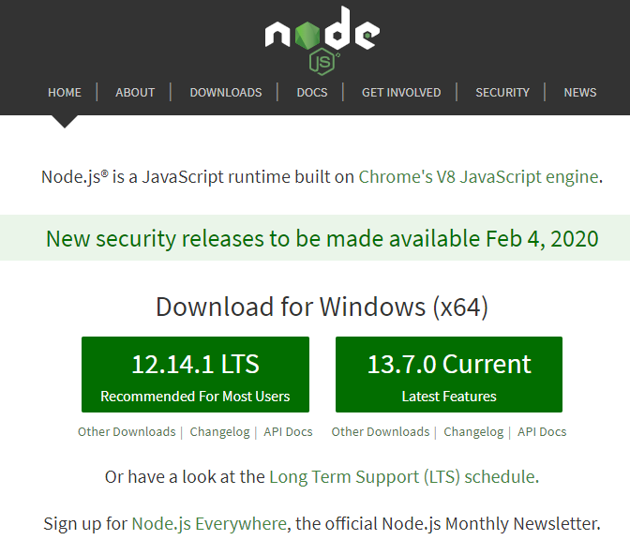
Download Node.js
Download Node.js from the official Node.js web site: https://nodejs.org
Always download the LTS version, as it is the latest stable version.
After installation, in the command prompt, type:
node --version

Slide 24
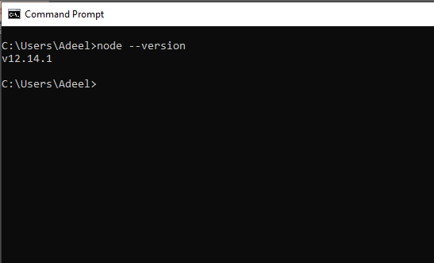
Check and verify version of node.js installed

Slide 25
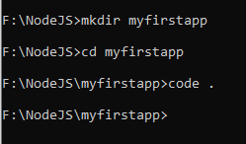
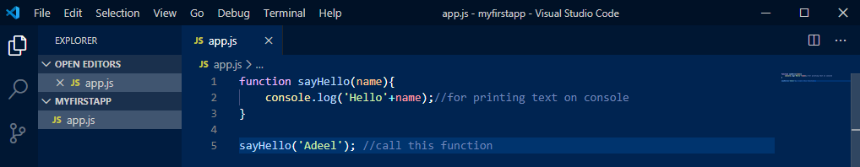
My First Application
Make sure Visual Studio Code is installed.
Create a new folder, let’s say “myfirstapp”. Fire up visual studio code via command prompt with “code .”
Create a file called “app.js” and type the following:

Slide 26

Execute the application
After saving the “app.js” file, go back to the command prompt, where the file is saved and type the following command to execute the app.js file:
node app.js
function sayHello(name){
console.log('Hello'+name);//for printing text on console
}
sayHello('Adeel'); //call this function

Slide 27
Console.log()
The console.log() method prints text within the Command Line Interface.
console.log('This example is different!'); console.log('The result is displayed in the Command Line Interface');

Slide 28
Summary
Why Node.js?
Node.js uses asynchronous programming!
Node.js is an open source server environment
Node.js is free
Node.js runs on various platforms (Windows, Linux, Unix, Mac OS X, etc.)
Node.js uses JavaScript on the server
Node.js eliminates the waiting, and simply continues with the next request.
Node.js runs single-threaded, non-blocking, asynchronously programming, which is very memory efficient.

Slide 29
How much javascript is needed for node.js
I would recommend you to have a good grasp of the main JavaScript concepts before diving into Node.js:
Lexical Structure
Expressions
Types
Variables
Functions
this
Arrow Functions
With those concepts in mind, you are well on your road to become a proficient JavaScript developer, in both the browser and in Node.js.
Loops
Scopes
Arrays
Template Literals
Semicolons
Strict Mode
ECMAScript 6, 2016, 2017

Slide 30
New Concepts in node.js
The following concepts are also key to understand asynchronous programming, which is one fundamental part of Node.js:
Asynchronous programming and callbacks
Timers
Promises
Async and Await
Closures
The Event Loop

Slide 31
GitHub link
Follow and share your code on GitHub:
For announcement, updates and course information, keep visiting:
https://github.com/adeelansari2785
https://sites.google.com/view/adeelansari/home

Slide 32
References
https://nodejs.dev/how-to-install-nodejs
https://www.w3schools.com/nodejs/nodejs_get_started.asp
https://www.udemy.com/course/all-about-nodejs/
https://www.udemy.com/course/nodejs-master-class/

